Slide 1
Member Initializer List
You have used initializer lists with arrays
int arr[] = {1,2,3,4,5};
The data members of a class can also be initialized using an initializer list with the constructor

Slide 2
Member Initializer List
class Test {
int marks;
int total;
public:
//inline with initializer list
Test() : marks(0),total(0) {} //default constructor
Test(int m, int t) : marks(m), total(t) {}
int getMarks() {
return marks;
}
int getTotal() {
return total;
}
};

Slide 3
Member Initializer List
class Test {
int marks;
int total;
public:
Test(); //prototype
Test(int, int ); //prototype
int getMarks() {
return marks;
}
int getTotal() {
return total;
}
};
//out of line with initializer list
Test::Test() :marks(0), total(0) {}
Test::Test(int m,int t): marks(m), total(t) {}

Slide 4
When to use Member Initializer List
You can use initializer list to initialize member variables but it is not necessary
But you must use an initializer list for
Initializing a constant data member
Initializing a reference member

Slide 5
const Class Members
As with member functions, data members can also be const
Constant members must be initialized using member initializer list

Slide 6
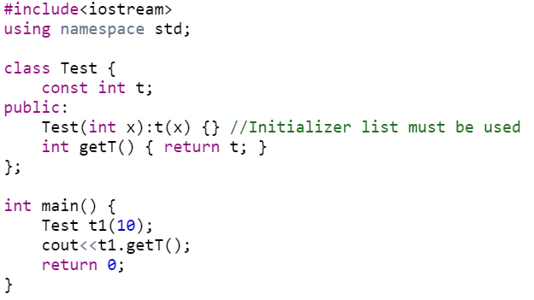
Member Initializer List (non-static const)

Slide 7
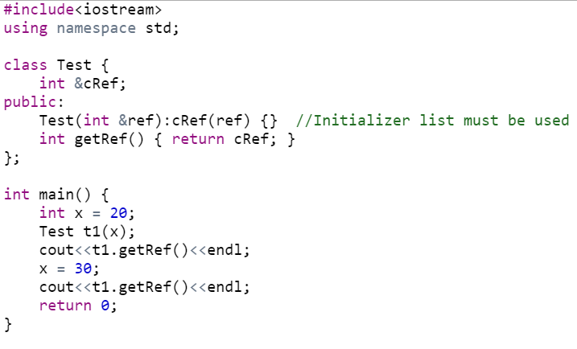
Member Initializer List (References)

Slide 8
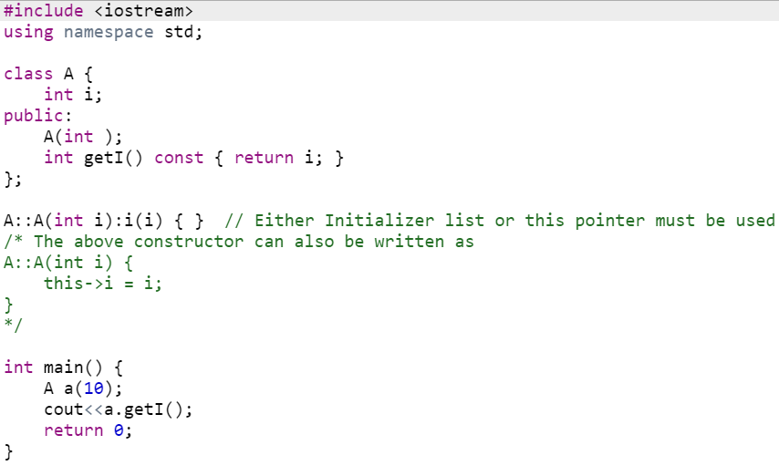
Member Initializer List (parameter name same as data member)

Slide 9
const Objects
Read-only objects
Object data members can only be read, NO write/update of data member allowed
Requires all member functions be const (except constructors and destructors)
const object must be initialized (using constructors) at the time of object creation
Notes:
The const property of an object goes into effect after the constructor finishes executing and ends before the class's destructor executes. So the constructor and destructor can modify the object, but other methods of the class can't.
The reason for this is that the compiler cannot decide whether a method performs write operations or only read operations with data members unless additional information is supplied.

Slide 10
const Objects
const property of an object goes into effect after the constructor finishes executing and ends before the class's destructor executes
So the constructor and destructor can modify the object

Slide 11
friend Functions
A friend function is a function that is not a member of a class, but has access to the private members of the class
In other words, a friend function is treated as if it were a member of the class
A friend function can be a regular stand-alone function, or it can be a member of another class.
An entire class can also be declared a friend of another class

Slide 12
friend Functions
To declare a friend function
Type friend before the function prototype in the class that is giving friendship
friend int myFunction( int );
should appear in the class giving friendship

Slide 13
friend Functions
friend functions
Can access private members of another class
Properties of friendship
Friendship is granted, not taken
Not symmetric (if B a friend of A, A not necessarily a friend of B)
Not transitive (if A a friend of B, B a friend of C, A not necessarily a friend of C)

Slide 14
1 // Fig. 7.5: fig07_05.cpp
2 // Friends can access private members of a class.
3 #include <iostream>
setA a friend of class Count (can access private data).
4
5 using std::cout;
6 using std::endl;
7
8 // Modified Count class
9 class Count {
10 friend void setA( Count &, int ); // friend function declaration
11 public:
12 Count() { a = 0; } // constructor
13 void print() const { cout << x << endl; } // output
14 private:
15 int a; // data member
16 };
setA is defined normally and is not a member function of Count.
17
18 // Can modify private data of Count because
19 // setX is declared as a friend function of Count
20 void setA( Count &c, int val )
Changing private variables allowed.
21 {
22 c.x = val; // legal: setX is a friend of Count
23 }
24 int main()
25 {
26 Count counter;
27 cout << "counter.a after instantiation: ";
28 counter.print();

Slide 15
29 cout << "counter.a after call to setA friend function: ";
30 setA( counter, 8 ); // set a with a friend
31 counter.print();
32 return 0;
33 }
counter.a after instantiation: 0
counter.a after call to setA friend function: 8
private data was changed.

Slide 16
1 // Fig. 7.6: fig07_06.cpp
2 // Non-friend/non-member functions cannot access
3 // private data of a class.
4 #include <iostream>
5
6 using std::cout;
cannotSetA is not a friend of class Count. It cannot access private data.
7 using std::endl;
8
9 // Modified Count class
10 class Count {
11 public:
12 Count() { x = 0; } // constructor
13 void print() const { cout << x << endl; } // output
14 private:
15 int x; // data member
16 };
17
18 // Function tries to modify private data of Count,
19 // but cannot because it is not a friend of Count.
20 void cannotSetA( Count &c, int val )
21 {
22 c.x = val; // ERROR: 'Count::x' is not accessible
23 }
24
cannotSetA tries to modify a private variable…
25 int main()
26 {
27 Count counter;
28
29 cannotSetX( counter, 3 ); // cannotSetX is not a friend
30 return 0;
31 }

Slide 17
Compiling...
Fig07_06.cpp
D:\books\2000\cpphtp3\examples\Ch07\Fig07_06\Fig07_06.cpp(22) :
error C2248: 'x' : cannot access private member declared in
class 'Count'
D:\books\2000\cpphtp3\examples\Ch07\Fig07_06\
Fig07_06.cpp(15) : see declaration of 'x'
Error executing cl.exe.
test.exe - 1 error(s), 0 warning(s)
Expected compiler error - cannot access private data

Slide 18
friend Functions and friend Classes
Friends should be used only for limited purpose
Too many functions declared as friends with private data access, lessens the value of encapsulation
Encapsulation in OOP is about hiding the complex details of an object’s internal workings and providing a simple interface to interact with it

Slide 19
#include <iostream>
using namespace std;
class BankAccount {
private:
double balance; // Private data member (encapsulated)
public:
// Constructor to initialize account balance
BankAccount(double initial_balance) : balance(initial_balance) {}
// Getter function: Access balance (read-only)
double getBalance() const {
return balance;
}

Slide 20
// Setter function: Deposit money into the account (write-only)
void deposit(double amount) {
if (amount > 0) {
balance += amount;
cout << "Deposited: $" << amount << endl;
} else {
cout << "Invalid deposit amount!" << endl;
}
}
// Setter function: Withdraw money (write-only with validation)
void withdraw(double amount) {
if (amount > 0 && amount <= balance) {
balance -= amount;
cout << "Withdrew: $" << amount << endl;
} else {
cout << "Insufficient funds or invalid withdrawal amount!" << endl;
}
}
};

Slide 21
int main() {
BankAccount account(1000); // Create an account with an initial balance of $1000
cout << "Initial Balance: $" << account.getBalance() << endl;
account.deposit(200); // Deposit $200 into the account
cout << "Balance after deposit: $" << account.getBalance() << endl;
account.withdraw(500); // Withdraw $500
cout << "Balance after withdrawal: $" << account.getBalance() << endl;
account.withdraw(800); // Attempt to withdraw more than the balance
cout << "Final Balance: $" << account.getBalance() << endl;
return 0;
}

Slide 22
Inheritance-I

Slide 23
What Is Inheritance?
One of the most powerful features of OOP
Provides a way to create a new class from an existing class
The new class inherits all the capabilities of the existing class and can also add capabilities of its own.
The base class is unchanged by this process.
The new class is a specialized version of the existing class

Slide 24
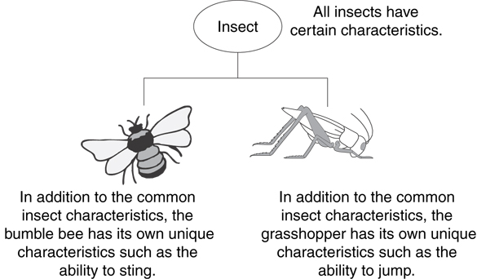
Example: Insects
Insect is generic
Bee and grasshopper are specific

Slide 25
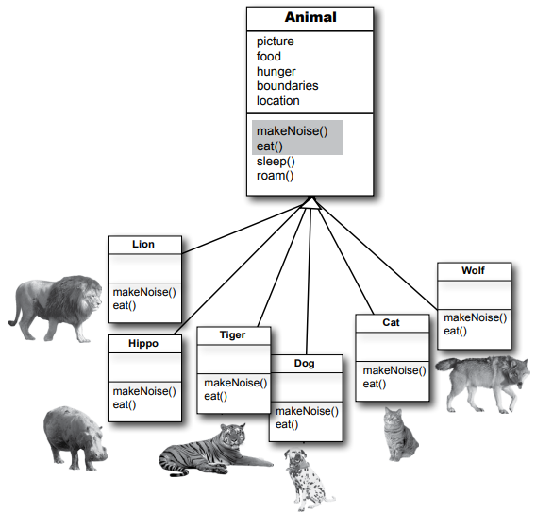
The “IS - A" Relationship
Inheritance establishes an “IS - A" relationship between classes.
A poodle is a dog
A car is a vehicle
A flower is a plant
A football player is an athlete

Slide 26
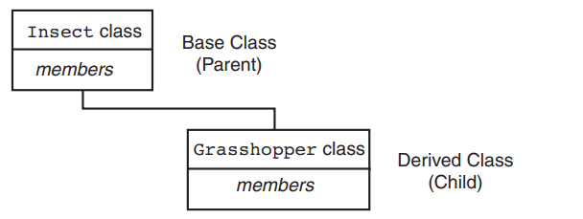
Introduction - Inheritance
Existing classes are called base classes
New classes are called derived classes

Slide 27
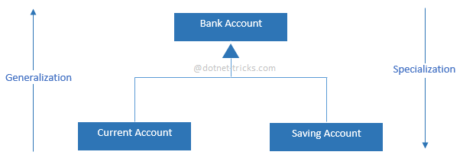
Introduction - Inheritance
Objects of derived classes are more specialized as compared to objects of their base classes

Slide 28
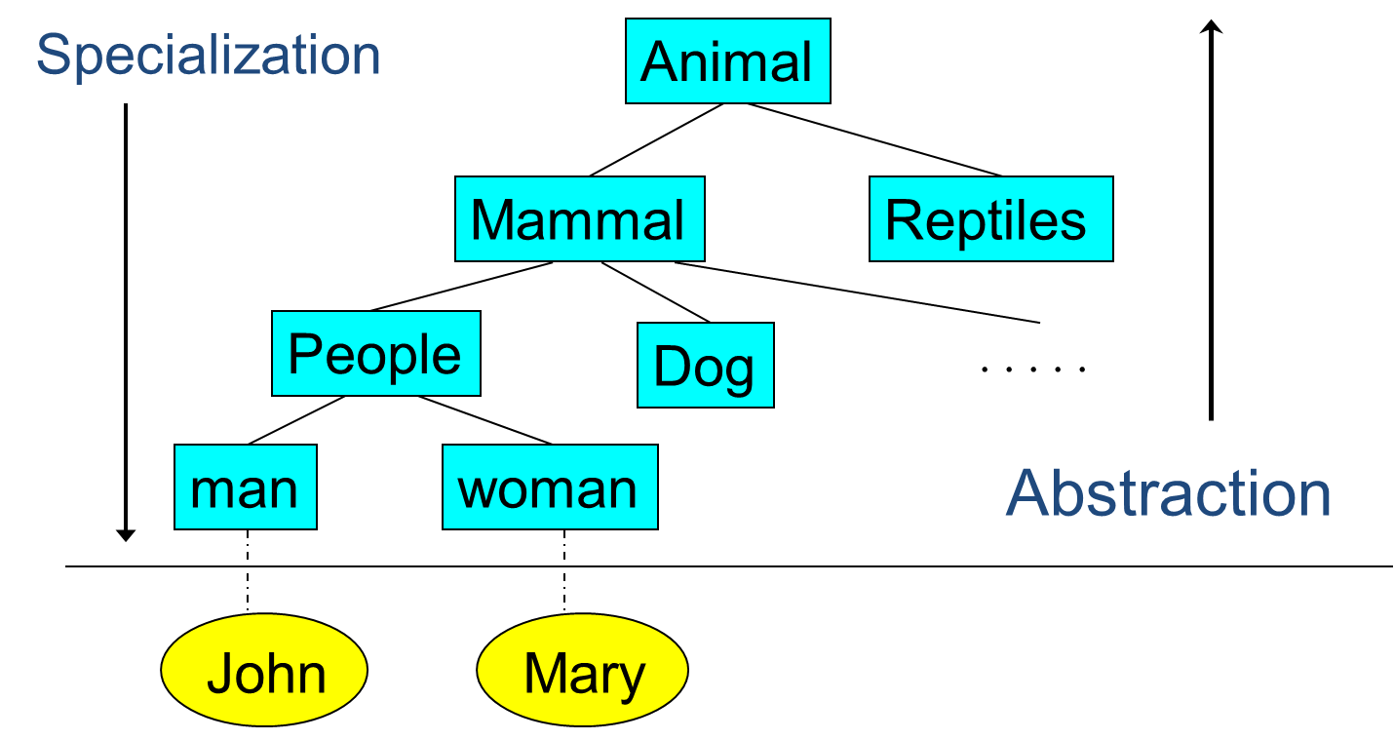
Animals: Class’s hierarchy

Slide 29
Inheritance Examples

Slide 30
Another example: Shapes class hierarchy
Shape
TwoDimensionalShape
ThreeDimensionalShape
Circle
Square
Triangle
Sphere
Cube
Tetrahedron

Slide 31
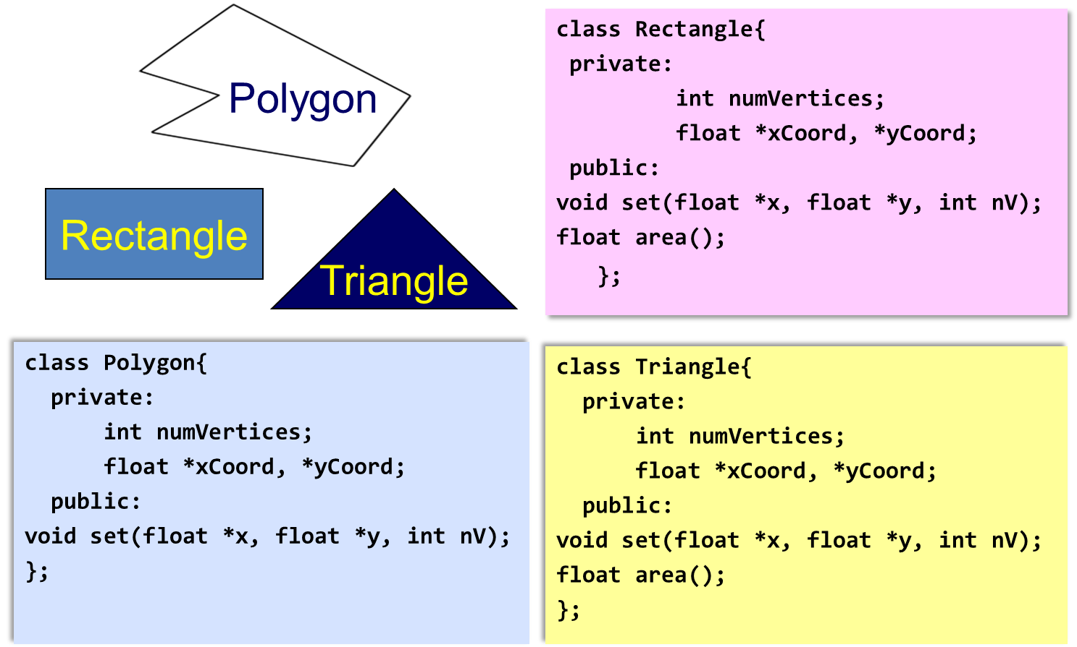
Why Inheritance?

Slide 32
Why Inheritance?
Inheritance provides us a mechanism of software reusability which is one of the most important principles of software engineering
Show similarities
Easy modification by performing modification in one place
Avoid redundancy, leading to smaller and more efficient model, easier to understand

Slide 33
Inheritance – Terminology and Notation
Base class (or parent or superclass) – inherited from
Derived class (or child or subclass) – inherits from the base class
Notation:
class Student // base class
{
};
class UnderGrad : public Student
{ // derived class
};

Slide 34
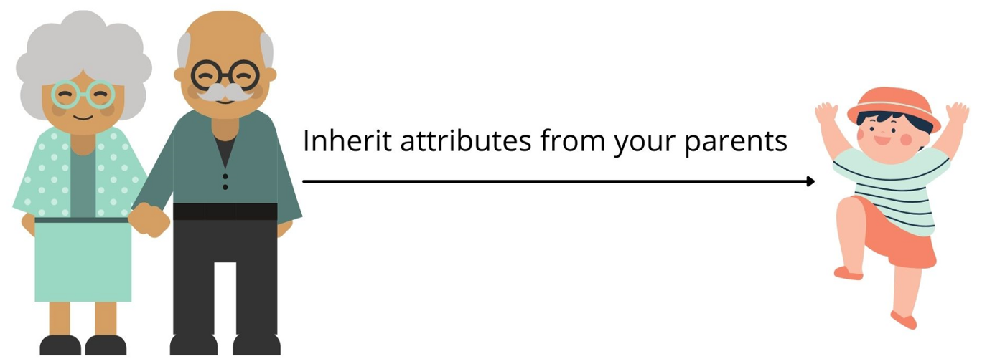
Inheriting Data and Functions
All data members and member functions of base class are inherited to derived class, except
Constructors, destructors and = operator are not inherited

Slide 35
What Does a Child Class Have?
In the Student and underGrad example shown earlier:
An object of the derived class has:
all members defined in child class
all members of the parent class except constructors, destructors and operator=
An object of the derived class can use:
all public members defined in child class
all public members defined in parent class

Slide 36
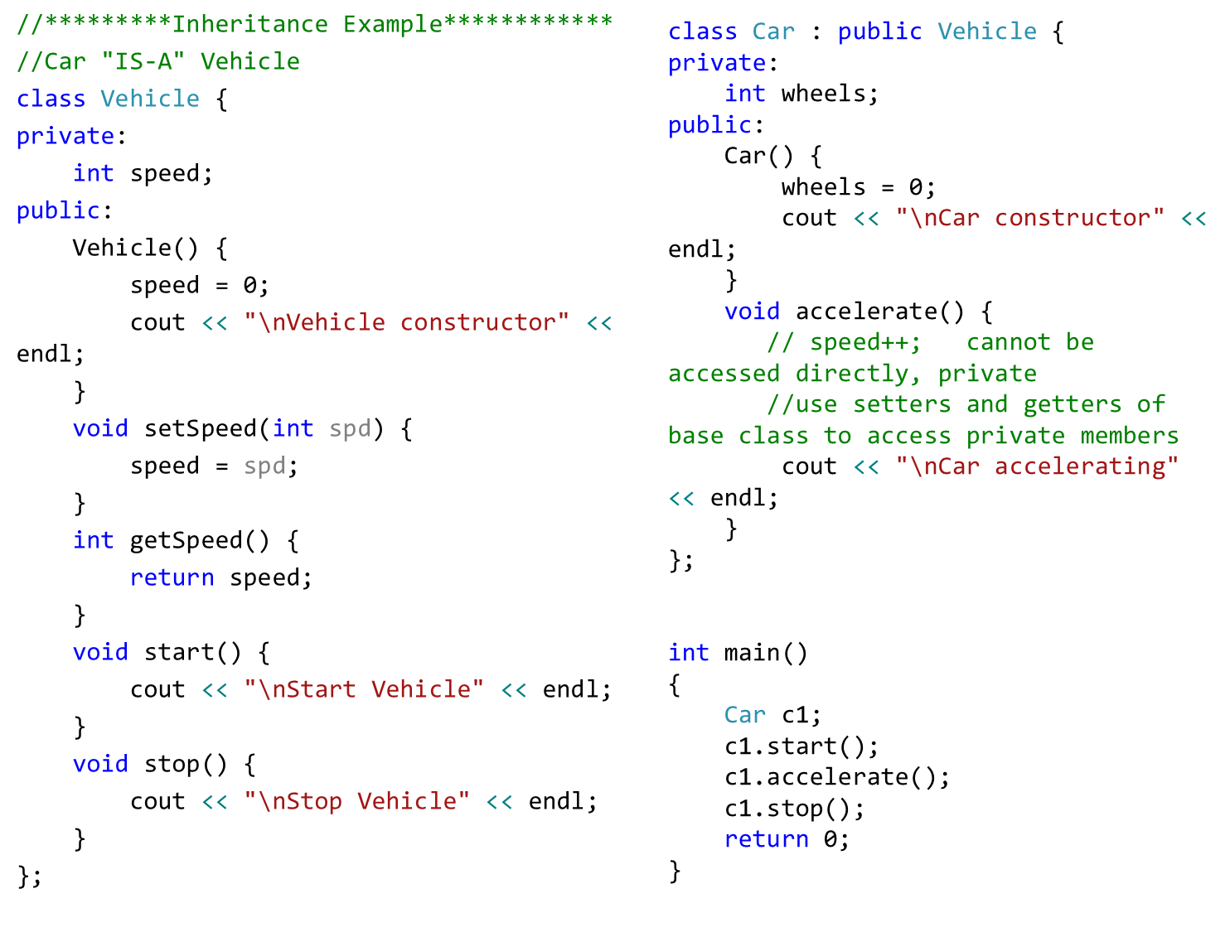

Slide 37
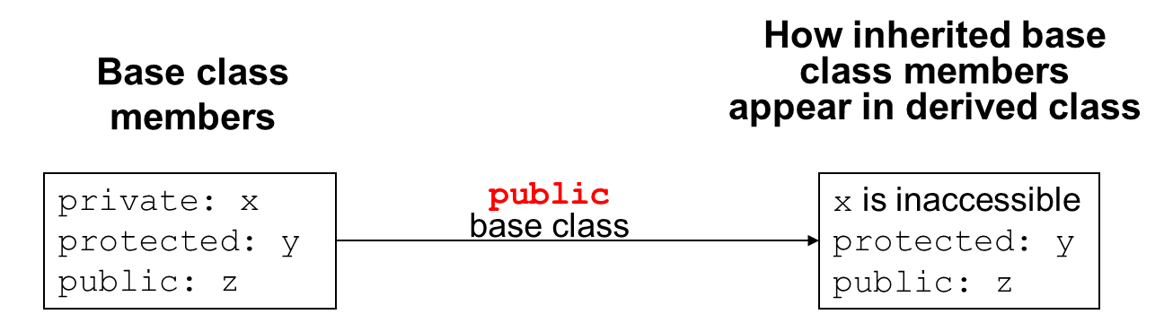
Protected Members and Class Access
protected member access specification: like private, but accessible by objects of derived class

Slide 38
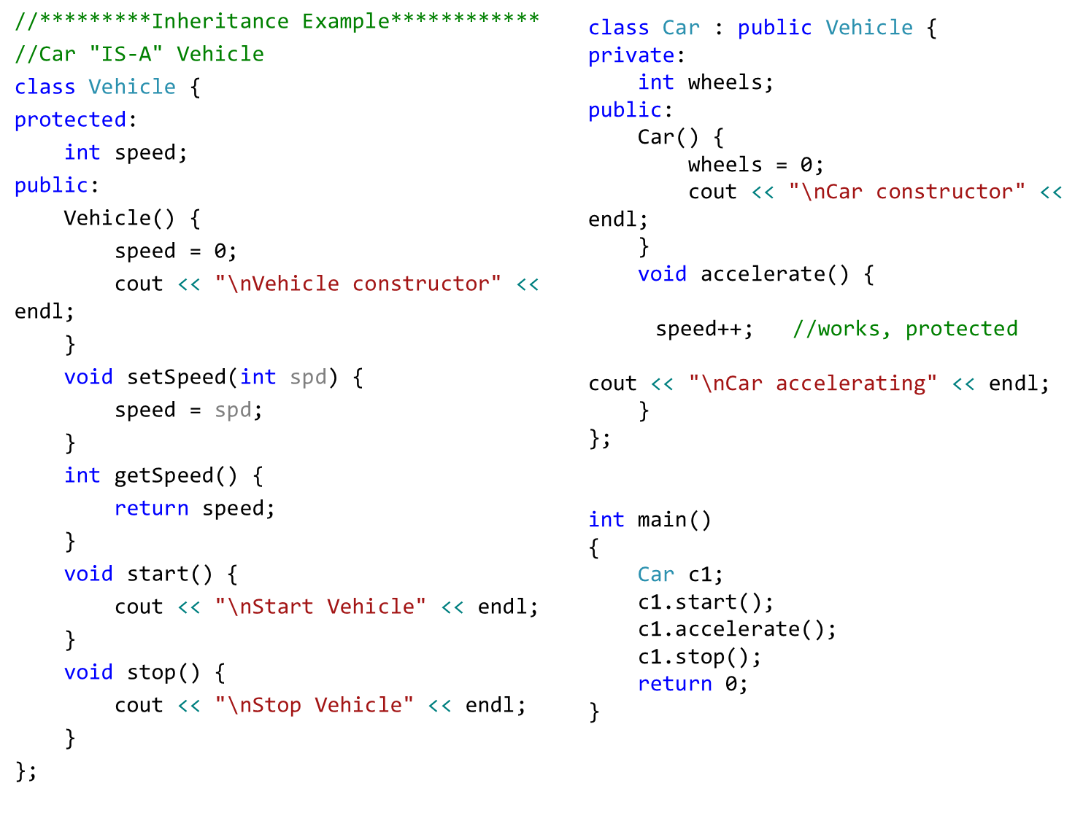

Slide 39
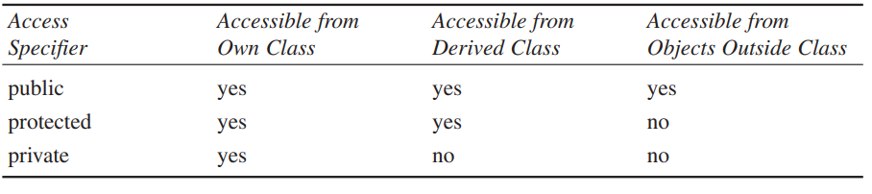
Protected Members and Class Access
protected member access specification: like private, but accessible by objects of derived class

Slide 40
Protected Members and Class Access
protected member access specification: like private, but accessible by objects of derived class
Class access specification: determines how private, protected, and public members of base class are inherited by the derived class

Slide 41
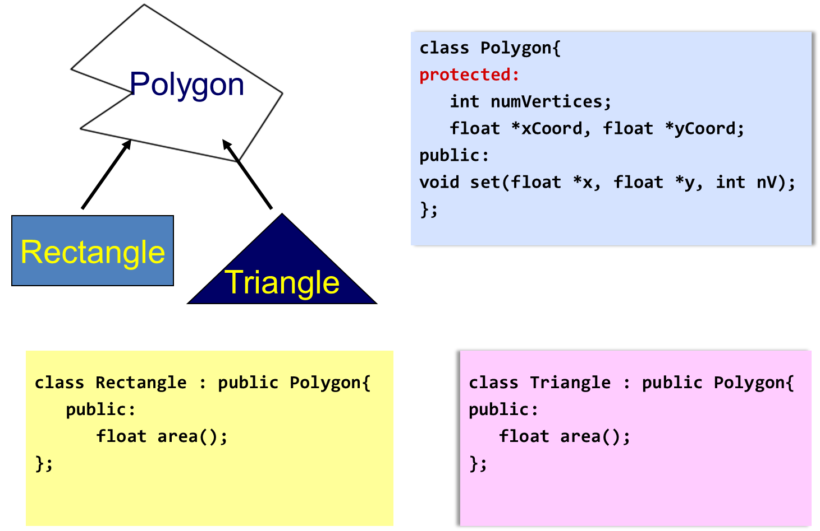
Inheritance Example 1

Slide 42
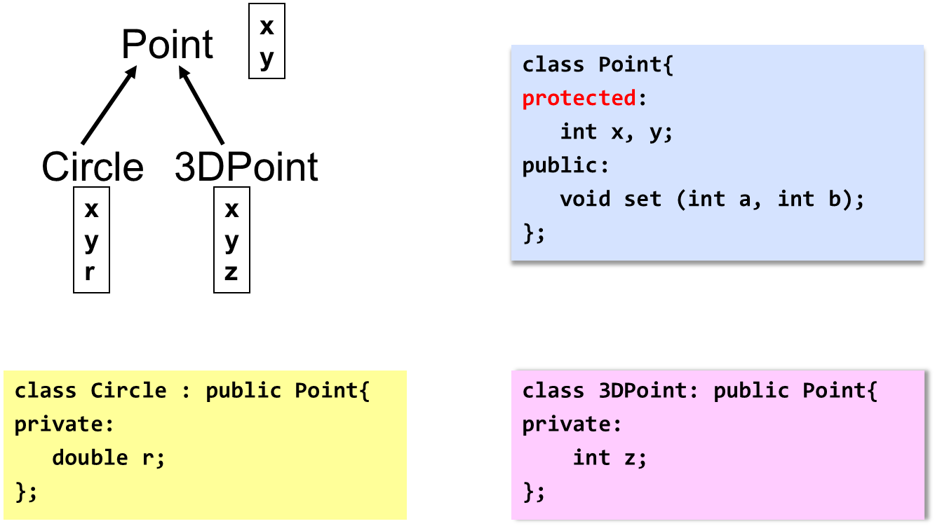
Inheritance Example 2

Slide 43
Dangers of Protected
You should know that there’s a disadvantage to making class members protected.
Say you’ve written a class library, which you’re distributing to the public. Any programmer can access protected members of your classes simply by deriving other classes from them.
This makes protected members considerably less secure than private members.
To avoid corrupted data, it’s often safer to force derived classes to access private data in the base class using only public setters and getters.

Slide 44
Constructors and Destructors in Base and Derived Classes
Constructors and destructors of Base class are NOT inherited
Derived classes can have their own constructors and destructors
When an object of a derived class is created, the base class’s constructor is executed first, followed by the derived class’s constructor
When an object of a derived class is destroyed, its destructor is called first, then that of the base class

Slide 45
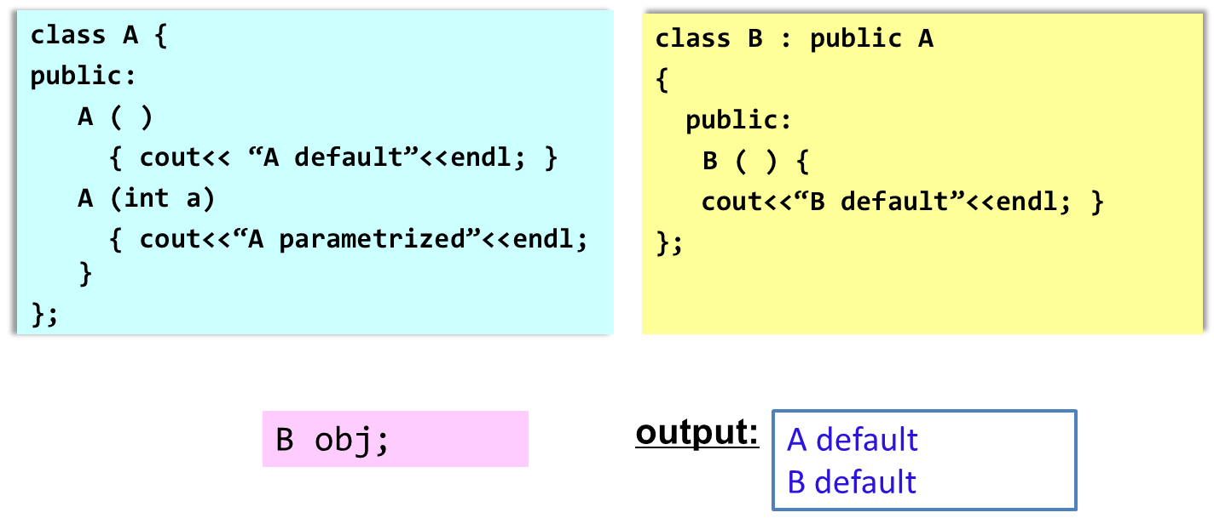
Constructor Rules for Derived Classes
The default constructor and the destructor of the base class are always called when a new object of a derived class is created or destroyed.

Slide 46

Constructor Rules for Derived Classes
The default constructor and the destructor of the base class are always called when a new object of a derived class is created or destroyed.

Slide 47
Passing Arguments to Base Class Constructor
Allows selection between multiple base class constructors
Specify arguments to base constructor on derived constructor heading
Inline constructor syntax:
Square(int side) : Rectangle(side, side)
Can also be done with out-of-line constructors
Square::Square(int side):Rectangle(side, side)
Must be done if base class has no default constructor

Slide 48
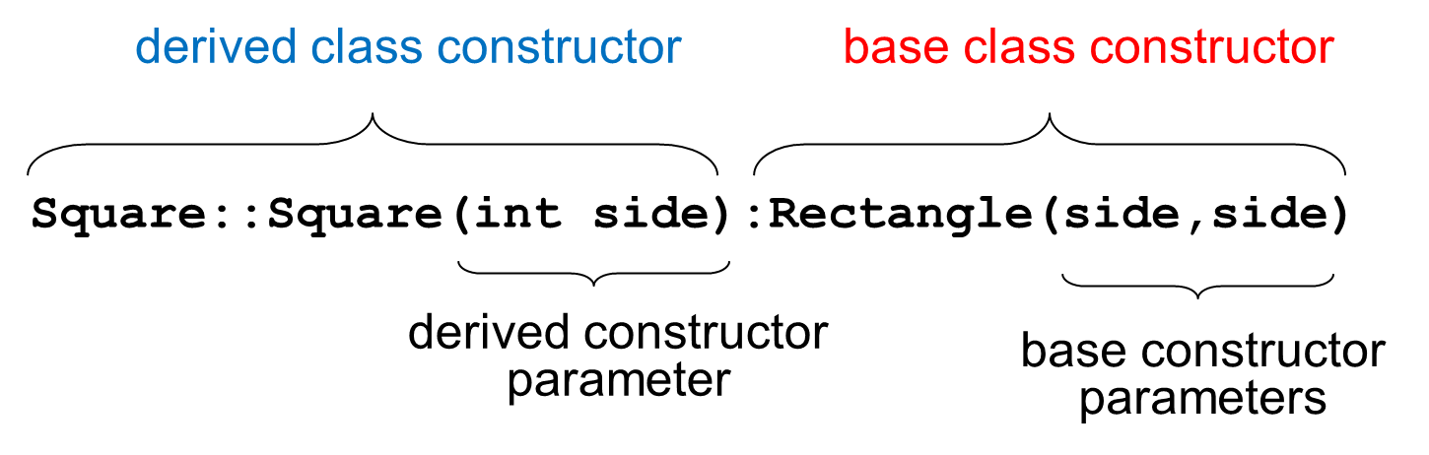
Passing Arguments to Base Class Constructor

Slide 49
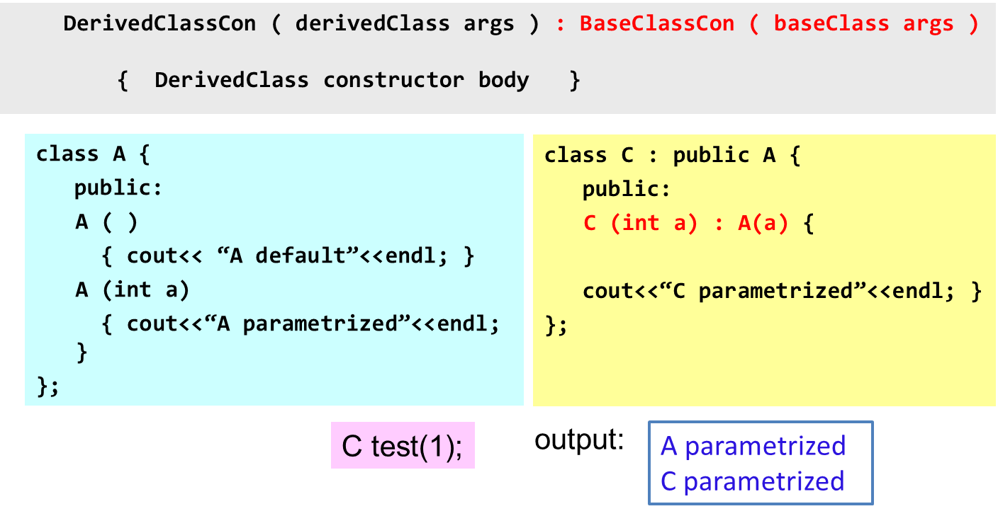
Constructor Rules for Derived Classes
You can specifically call a constructor of the base class other than the default constructor

Slide 50
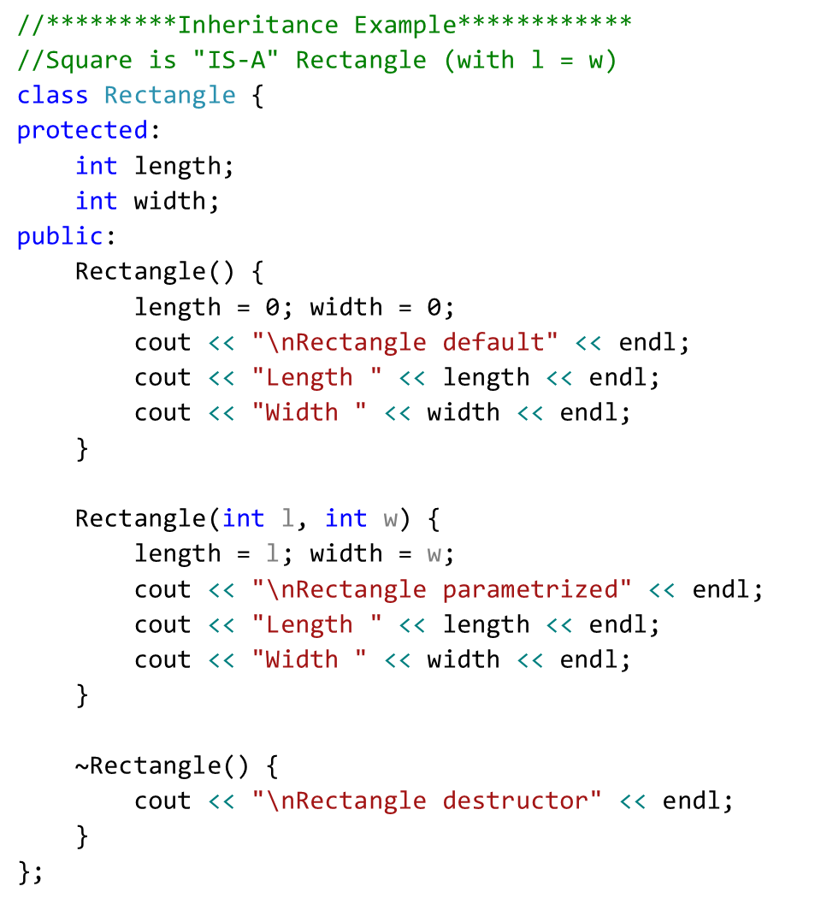

Slide 51
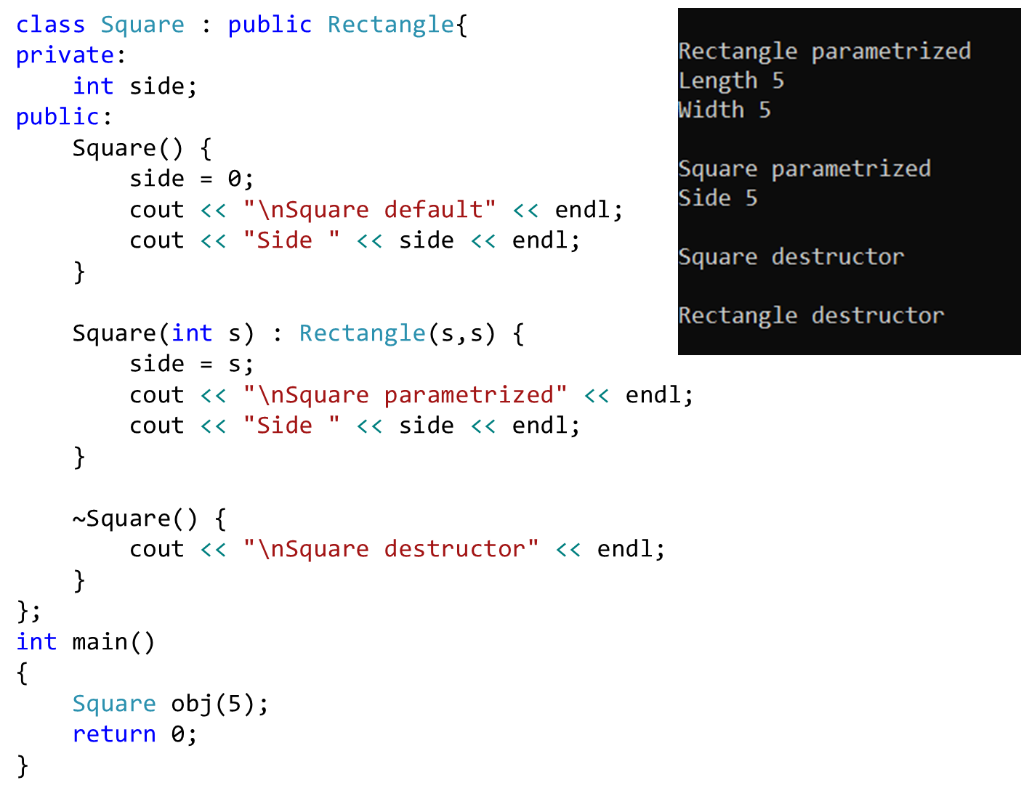

Slide 52
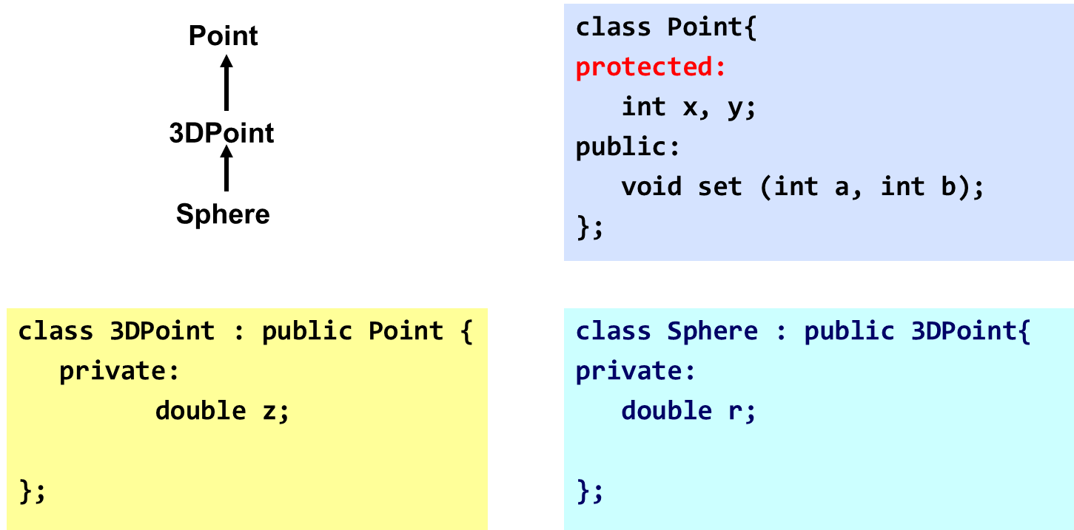
Class Derivation
Point is the base class of 3D-Point, while 3DPoint is the base class of Sphere

Slide 53
Order of execution of Constructors/Destructors
Chain of constructor calls:
Point → Circle → Cylinder
Point constructor executes first
Then circle and last Cylinder

Slide 54
Order of execution of Constructors/Destructors
Chain of destructor calls
Reverse order of constructor chain
Cylinder → Circle → Point
Destructor of derived-class called first
Destructor of next base class up hierarchy next
Continue up hierarchy until final base reached
After final base-class destructor, object removed from memory

Slide 55
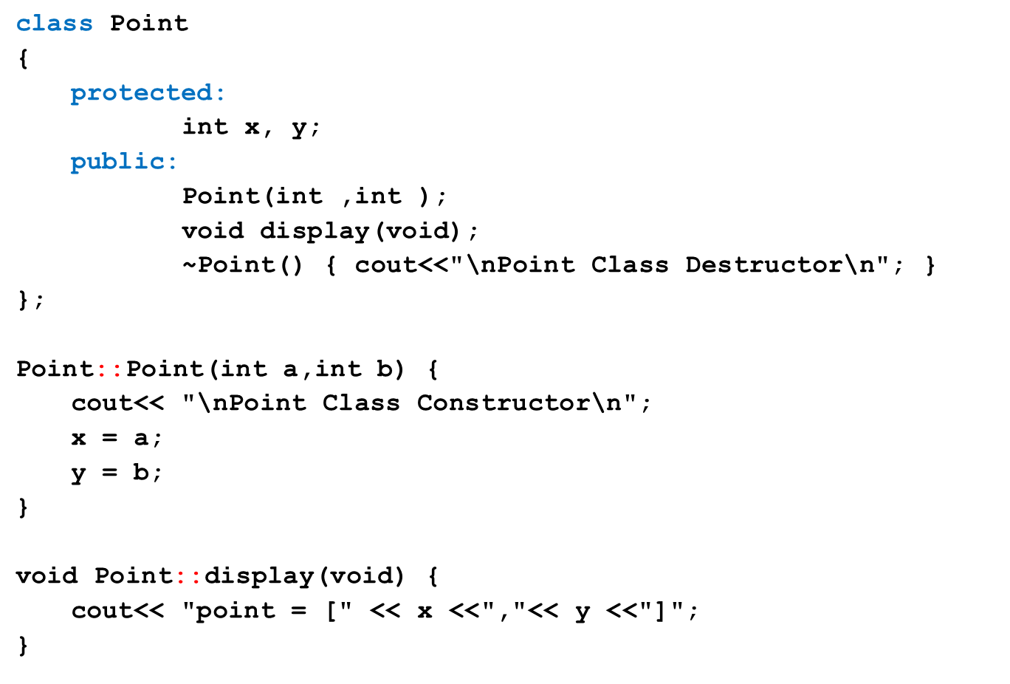
Example

Slide 56
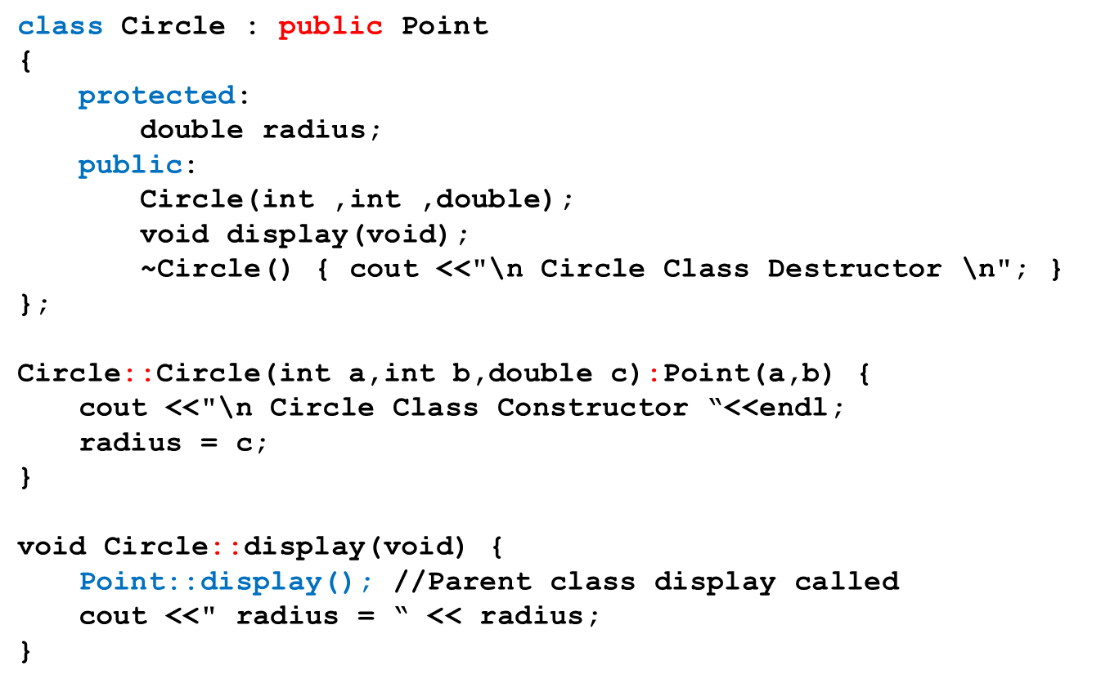
Example – cont.

Slide 57
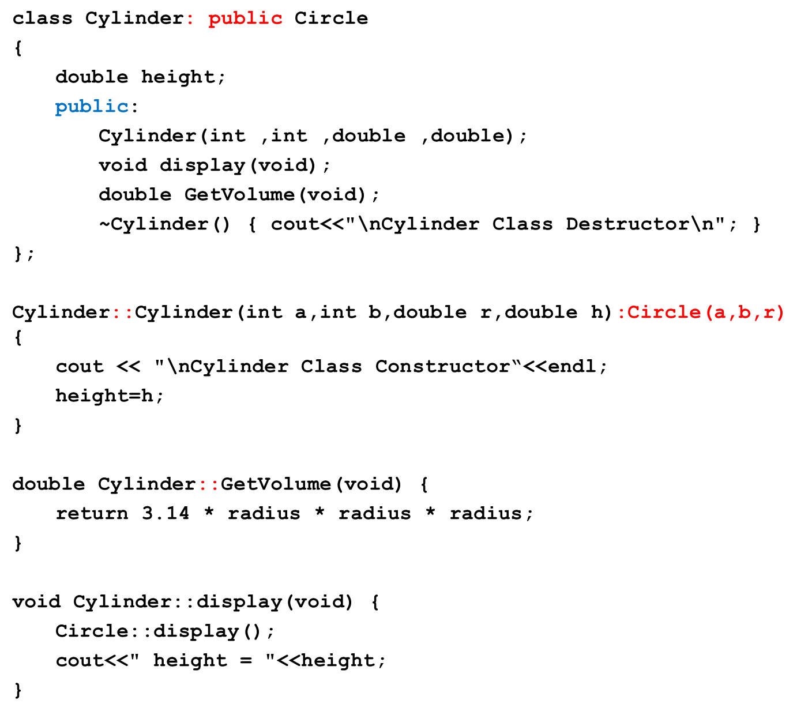

Slide 58
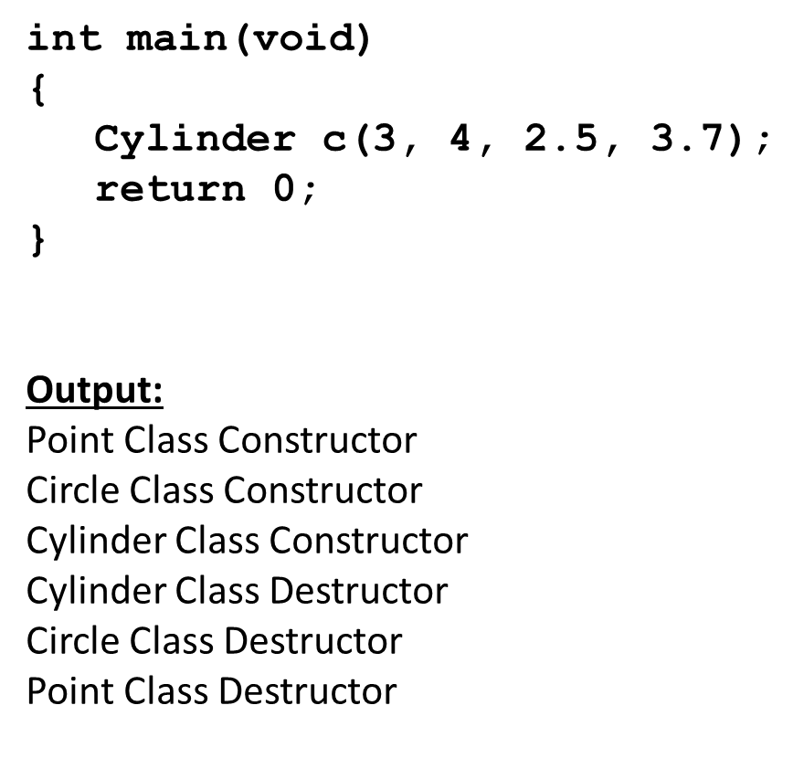
Example – cont.

Slide 59
Data vs Class Access Specifier
Two levels of access control over class members
class definition
inheritance type
class Point{
protected: int x, y;
public: void set(int a, int b);
};
class Circle : public Point{
… …
};

Slide 60
Types of inheritance/ Class access specifier
Public
Private
protected

Slide 61
Public Inheritance
With public inheritance,
public and protected members of the base class become respectively public and protected members of the derived class
class derived : public base{
… …
};

Slide 62
Protected Inheritance
Public and protected members of the base class become protected members of the derived class.
class derived : protected base{
… …
};

Slide 63
Private Inheritance
With private inheritance, public and protected members of the base class become private members of the derived class.
class derived : private base{
… …
};

Slide 64
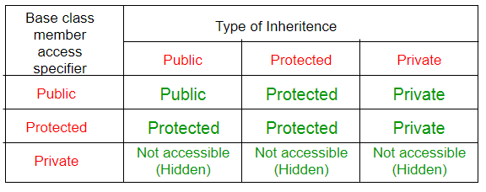
public, protected and private Inheritance

Slide 65
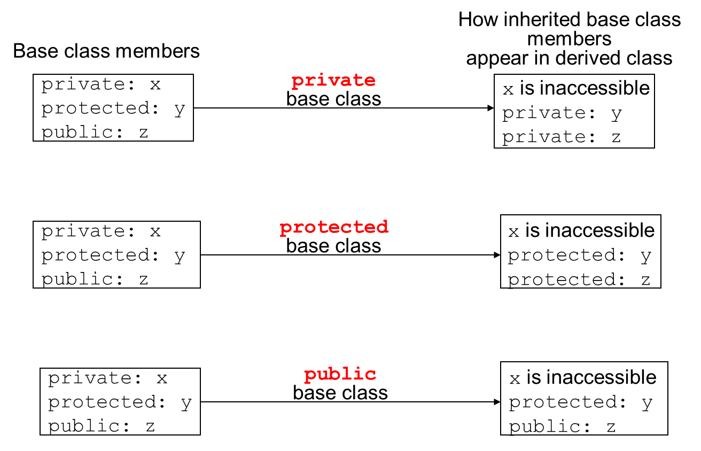
Inheritance vs. Access

Slide 66
Class Access Specifiers – When to use?
public – object of derived class can be treated as object of base class (not vice-versa)
protected – more restrictive than public, but allows derived classes to know details of parents
private – prevents objects of derived class from being treated as objects of base class.

Slide 67
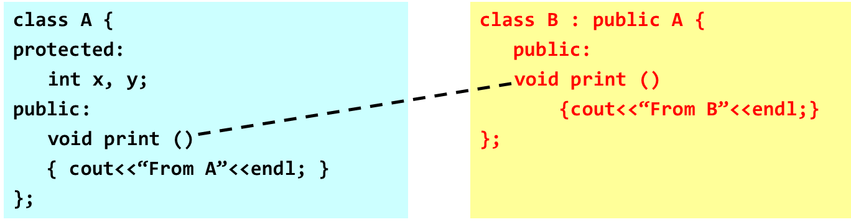
Method Overriding
A derived class can override methods defined in its parent class.
the method in the subclass must have the identical signature to the method in the base class.
a subclass implements its own version of a base class method.

Slide 68
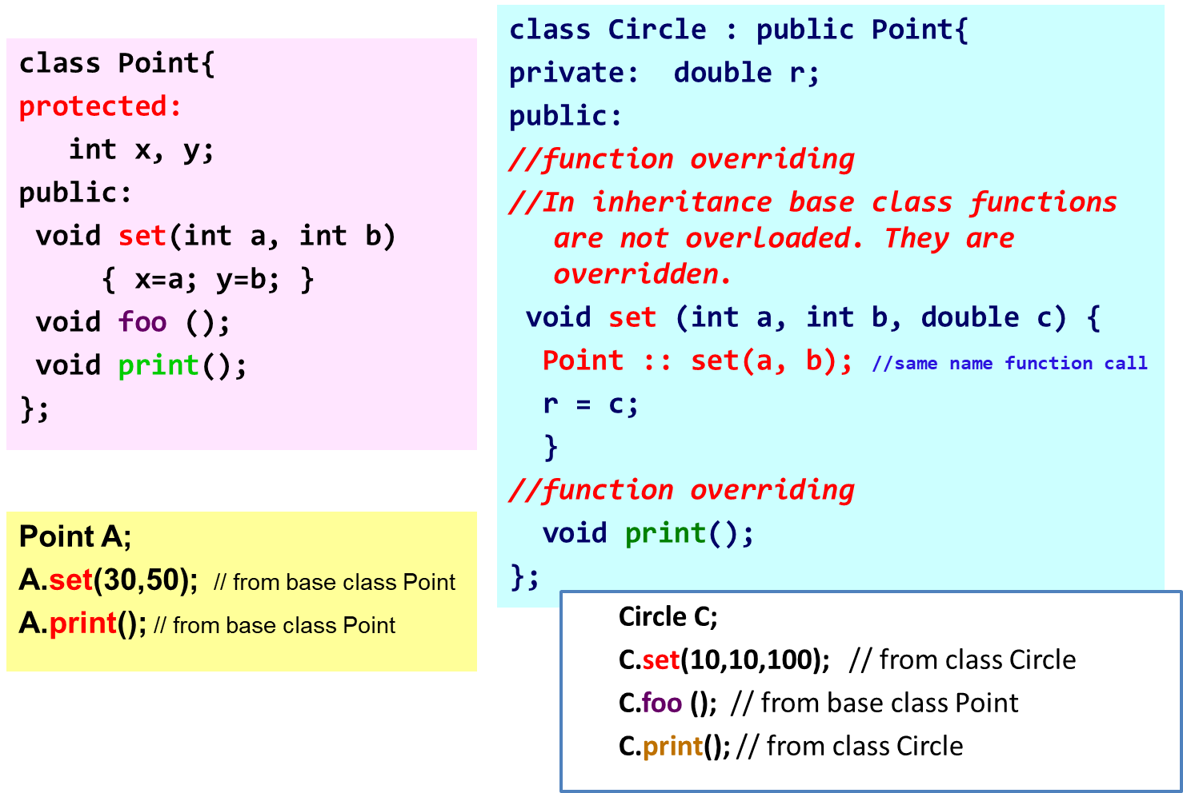
Method Overriding

Slide 69
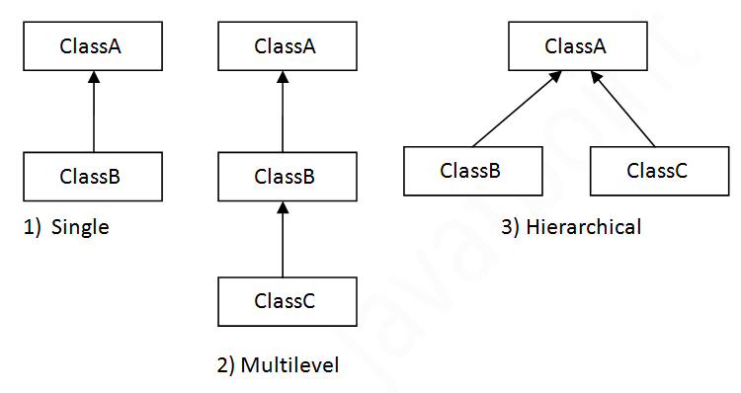
Types of Inheritance
Single inheritance
Inherits from one base class
Multi-level inheritance
Chain of inheritance
Multiple inheritance
Inherits from multiple classes

Slide 70
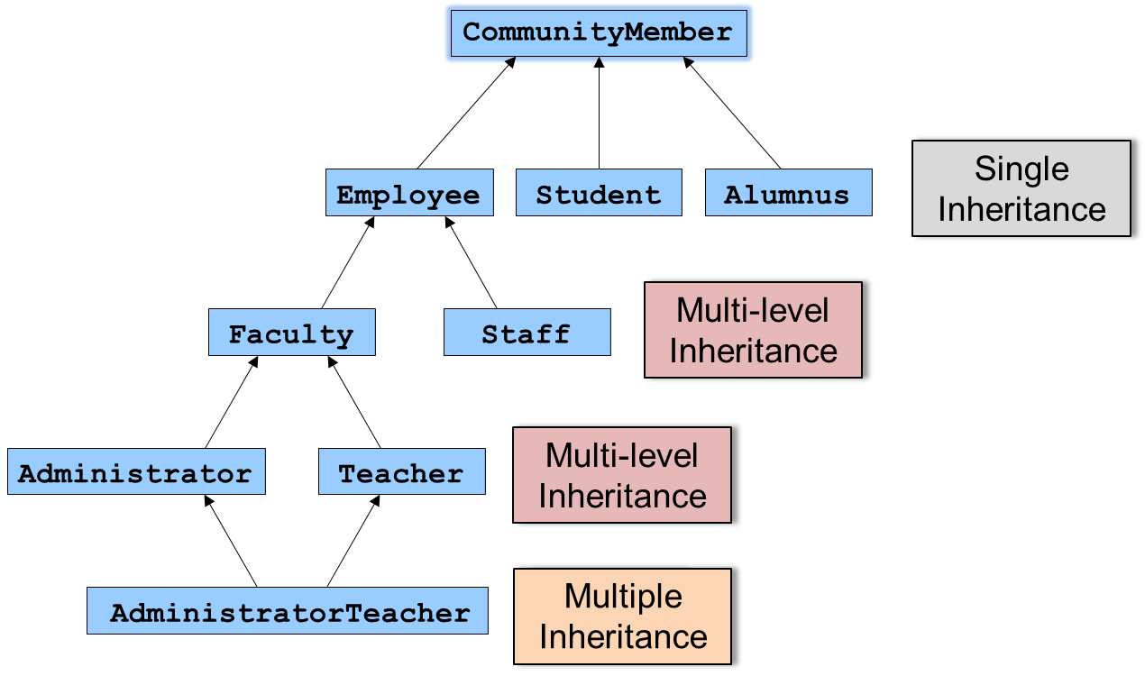
Types of Inheritance: University Example

Slide 71
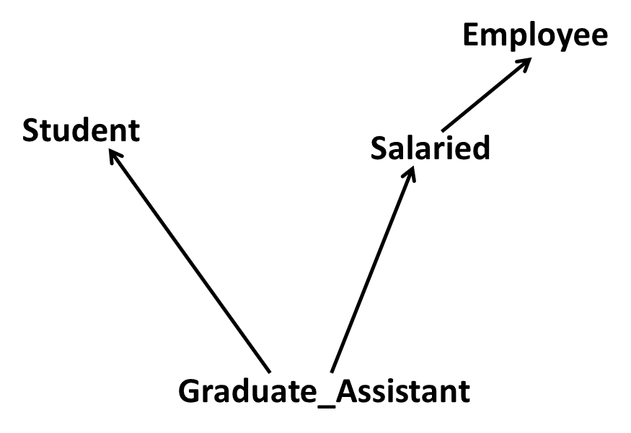
Multiple Inheritance

Slide 72
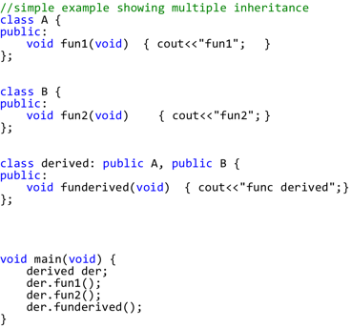
What is Multiple Inheritance?
If class A inherits from more than one class,
i.e., A → (B1, B2, ..., Bn), we speak of multiple inheritance.

Slide 73
Multiple Inheritance
This may introduce naming conflicts:
if at least two of its base classes define properties (data members or member functions) with the same name

Slide 74
Ambiguity in Multiple Inheritance
class Student {
int id;
int age;
public:
int GetAge() const { return age; }
int GetId() const { return id; }
void SetAge( int n ) { age = n; }
void SetId( int n ) { id=n; }
};

Slide 75
Ambiguity in Multiple Inheritance
class Employee {
public:
int GetAge() const { return age; }
int SetAge( int n ) { age = n; }
void SetId( int n) { id=n; }
int GetId(void) const { return id; }
private:
int age;
int id;
};

Slide 76
Ambiguity in Multiple Inheritance
class Salaried : public Employee {
float salary;
public:
float GetSalary() const { return salary; }
void SetSalary( float s ) { salary=s; }
};
class GradAssistant :public Student, public Salaried {
public:
void Display() const {
cout<<GetId()<<","<<GetSalary()<<","<<GetAge();
//ambiguity
}

Slide 77
Ambiguity in Multiple Inheritance
int main(void) {
GradAssistant ga;
ga.SetAge(20); //ambiguity
ga.SetId(15); //ambiguity
ga.Display(); //ambiguity inside display()
}
//program will not compile and will generate errors

Slide 78
What is the solution?
Call functions explicitly by specifying name of class and using scope resolution operator to remove ambiguity:
Direct solution:
Student::SetAge() or Salaried::SetAge()

Slide 79
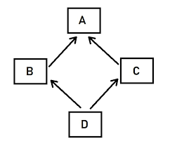
The Diamond Problem
class A {
public:
void Foo() {}
}
class B : public A {}
class C : public A {}
class D : public B, public C {}
D d;
d.Foo();
is this B's Foo() or C's Foo() ?? ambiguous

Slide 80
What is the solution?
Call functions explicitly by specifying name of class and using scope resolution operator to remove ambiguity:
Direct solution:
Student::SetAge() or Salaried::SetAge()
2. Virtual inheritance

Slide 81
Solution (virtual inheritance)
class A {
public: void Foo() {}
}
class B : public virtual A {
}
class C : public virtual A {
}
class D : public B, public C {
}
D d;
d.Foo(); // no longer ambiguous

Slide 82
Virtual Inheritance
Virtual inheritance is a C++ technique that ensures that only one copy of common base class's member variables are inherited by second-level derivatives (a.k.a. grandchild derived classes)

Slide 83
Example
class PoweredDevice{
public:
PoweredDevice(int nPower){
cout << "PoweredDevice: " <<
nPower << endl;
}
};

Slide 84
class Scanner: public PoweredDevice {
public:
Scanner(int nScanner, int nPower) : PoweredDevice(nPower)
{
cout << "Scanner: " << nScanner << endl;
}
};
class Printer: public PoweredDevice {
public:
Printer(int nPrinter, int nPower) : PoweredDevice(nPower)
{
cout << "Printer: " << nPrinter << endl;
}
};

Slide 85
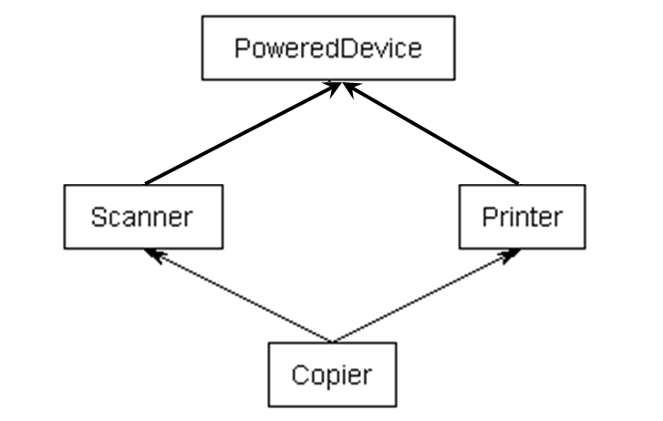
Example
class Copier: public Scanner, public Printer
{
public:
Copier(int nScanner, int nPrinter, int nPower) :
Scanner(nScanner, nPower), Printer(nPrinter, nPower){
}
};

Slide 86
Example
int main(){
Copier cCopier(1, 2, 3);
}
What should be the output?

Slide 87
Example
int main(){
Copier cCopier(1, 2, 3);
}
What should be the output?
PoweredDevice: 3
Scanner: 1
PoweredDevice: 3
Printer: 2

Slide 88
References
Book Code: A

